Slide 1

Simple Linear Regression
Presented by:
Elizer Ponio Jr.
Department of Computer Science
College of Computing and Information Technologies

Slide 2
Outline
What is Linear Regression?
Classification vs Regression
Types of Linear Regression
Understanding Simple Linear Regression
Gradient Descent

Slide 3

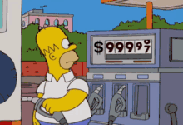

What is Linear Regression?
Current Jeepney Fare
Price of Fuel
Predicted Jeepney Fare
Based on the price of fuel, how much would be the jeepney fare?

Slide 4
What is Linear Regression?
Linear regression or simply regression is a statistical model used to predict the relationship between independent and dependent variables.

Slide 5
What is Linear Regression?
Independent Variable | Dependent Variable
A variable whose value does not change by the effect of other variables and is used to manipulate the dependent variable. Often denoted as X | A variable whose value changes when there is a manipulation in the values of the independent variables. Often denoted as Y
Price of
Fuel
Jeepney Fare

Slide 6
What is Linear Regression?
In Linear Regression, we examine two factors.
Which variables are significant predictors of the outcome variable?
How significant is the regression line in terms of making predictions with the highest possible accuracy?

Slide 7

What is Linear Regression?
Classification vs Regression
Types of Linear Regression
Understanding Simple Linear Regression
Gradient Descent

Slide 8
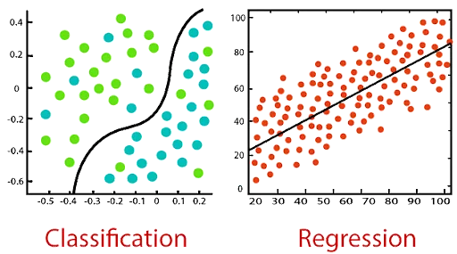
Classification vs Regression
Classification | Regression
The output variable must be a discrete value in the form of a class label. | The output variable must be either continuous in nature or a real value in the form of an integer quantity.
Classification algorithms solve classification problems like identifying spam e-mails, and spotting cancer cells . | It is used to solve problems such as predicting house prices and weather predictions.
Classification tries to find the decision boundary, which divides the dataset into different classes. | It attempt to find the best fit line, which predicts the output more accurately.

Slide 9
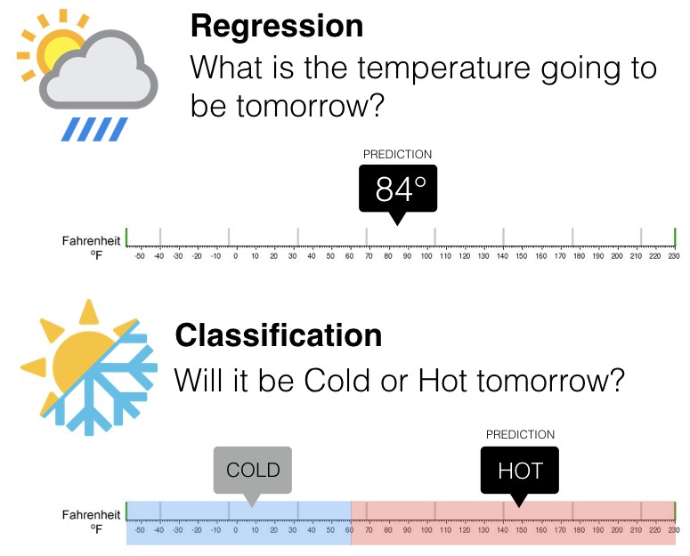
Classification vs Regression

Slide 10
What is Linear Regression?
Classification vs Regression
Types of Linear Regression
Understanding Simple Linear Regression
Gradient Descent

Slide 11
Types of Linear Regression
Simple Linear Regression | Multiple Linear Regression
This type involves estimating the relationship between two quantitative variables, such as the value of a dependent variable at a particular value of the independent variable. | In this type, you can determine the relationship between several independent variables and a dependent variable.

Slide 12


Simple Linear Regression
Crop Yield Prediction
Independent Variables
Dependent Variables
Rainfall
Crop yield/Amount of crop grown

Slide 13
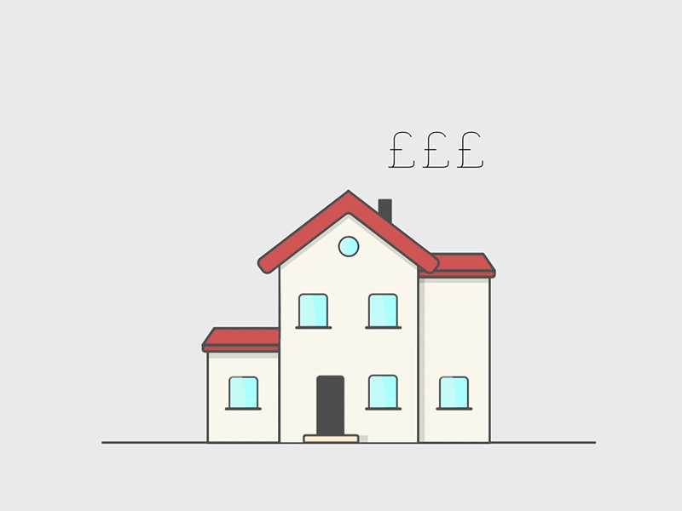

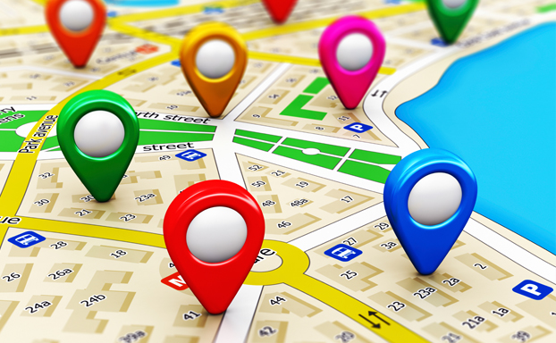

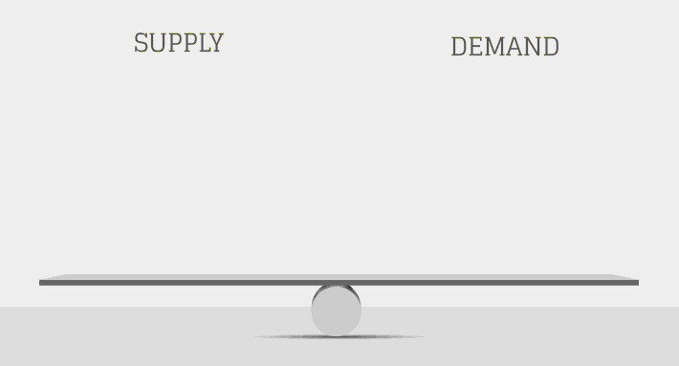
Multiple Linear Regression
House Price Prediction
Dependent Variables
Price
Independent Variables
Economic Conditions
Supply and Demand
Location

Slide 14
Types of Linear Regression
Classification
Simple Linear Regression
Regression
Multiple Linear Regression
Tasks in Supervised Learning
Polynomial Linear Regression
Notes:
Have you asked yourself the question, why do people organize?
Lets go to the psychology of organizing
This predictability applies within the context of our homes, manifesting through the concept of organization

Slide 15
What is Linear Regression?
Classification vs Regression
Types of Linear Regression
Understanding Simple Linear Regression
Gradient Descent
Notes:
Have you asked yourself the question, why do people organize?
Lets go to the psychology of organizing
This predictability applies within the context of our homes, manifesting through the concept of organization

Slide 16
Regression Line
Jeepney Fare (Y)
Price of Fuel (X)
Notes:
Have you asked yourself the question, why do people organize?
Lets go to the psychology of organizing
This predictability applies within the context of our homes, manifesting through the concept of organization

Slide 17
Least Squares Method
Price of Fuel (X) | Jeepney Fare (Y)
1 | 2
2 | 4
3 | 5
4 | 4
5 | 5
Notes:
Have you asked yourself the question, why do people organize?
Lets go to the psychology of organizing
This predictability applies within the context of our homes, manifesting through the concept of organization

Slide 18
Least Squares Method
Jeepney Fare (Y)
Price of Fuel (X)
Notes:
Have you asked yourself the question, why do people organize?
Lets go to the psychology of organizing
This predictability applies within the context of our homes, manifesting through the concept of organization

Slide 19
Least Squares Method
Price of Fuel (X) | Jeepney Fare (Y)
1 | 2
2 | 4
3 | 5
4 | 4
5 | 5
Jeepney Fare (Y)
Price of Fuel (X)
Notes:
Have you asked yourself the question, why do people organize?
Lets go to the psychology of organizing
This predictability applies within the context of our homes, manifesting through the concept of organization

Slide 20
Least Squares Method
Price of Fuel (X) | Jeepney Fare (Y) | (X * Y) | X²
1 | 2 | 2 | 1
2 | 4 | 8 | 4
3 | 5 | 15 | 9
4 | 4 | 16 | 16
5 | 5 | 25 | 25
Σx = 15
Σy = 20
Σxy = 66
Σx² = 55
Step 1: Get the sum of X, Y, (X * Y) and X²
Notes:
Have you asked yourself the question, why do people organize?
Lets go to the psychology of organizing
This predictability applies within the context of our homes, manifesting through the concept of organization

Slide 21
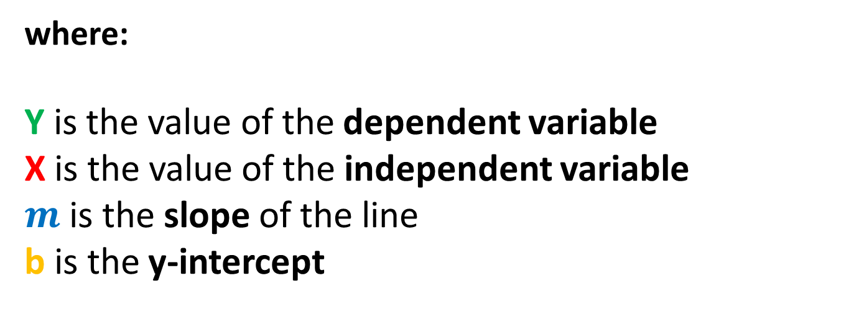
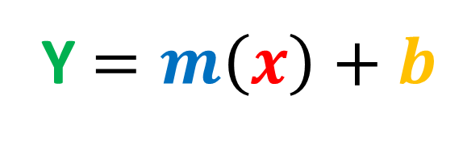
Equation of the Line
The equation of the Line is given by this formula:
Y $=m\left(x\right)+b$
where:
Y is the value of the dependent variable
X is the value of the independent variable
$m$ is the slope of the line
b is the y-intercept
Notes:
Have you asked yourself the question, why do people organize?
Lets go to the psychology of organizing
This predictability applies within the context of our homes, manifesting through the concept of organization

Slide 22
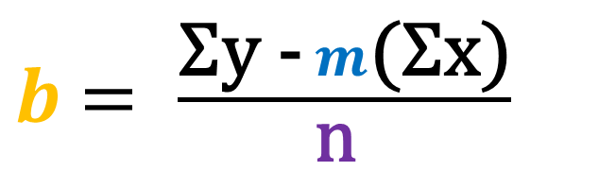
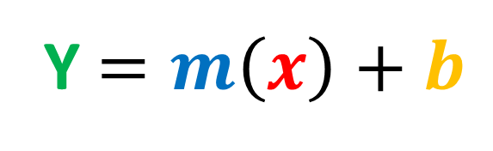
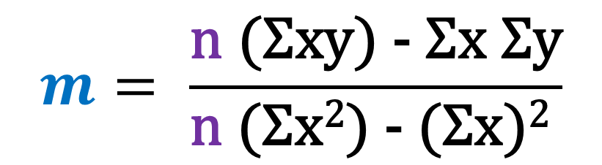
Equation of the Line
The equation of the Line is given by this formula:
Price of Fuel (X) | Jeepney Fare (Y)
1 | 1.5
2 | 3.8
3 | 6.7
4 | 9
5 | 11.2
6 | 13.6
7 | 16
Y $=m\left(x\right)+b$
Calculating the slope is given by this formula:
$$m= \frac{\text{n} \text{(}\text{Σ}\text{xy}\text{)}\text{ − }\text{Σ}\text{x} \text{Σ}\text{y}}{\text{n} \text{(}\text{Σ}\text{x}\text{2}\text{)}\text{ − }\text{(}\text{Σ}\text{x}\text{)}\text{2} }$$
Calculating the intercept is given by this formula:
$b$ $= \frac{\text{Σ}\text{y}\text{ −} m\text{(}\text{Σ}\text{x}\text{)}}{\text{n} }$
Notes:
Have you asked yourself the question, why do people organize?
Lets go to the psychology of organizing
This predictability applies within the context of our homes, manifesting through the concept of organization

Slide 23

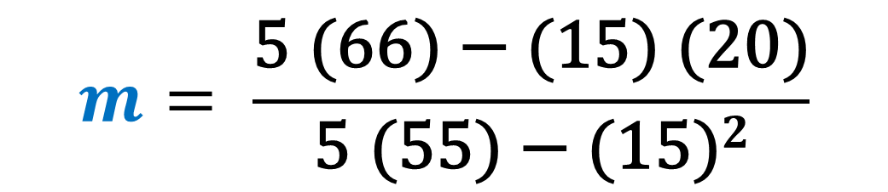
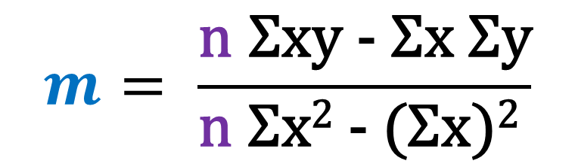
Calculate the Slope
Σx | Σy | Σxy | Σx²
15 | 20 | 66 | 55
$$m= \frac{\text{n} \text{Σ}\text{xy}\text{ − }\text{Σ}\text{x} \text{Σ}\text{y}}{\text{n} \text{Σ}\text{x}\text{2}\text{ − }\text{(}\text{Σ}\text{x}\text{)}\text{2} }$$
$$m= \frac{\text{5}\text{ (66)}\text{ − }\text{(15)} \text{(20)}}{\text{5} \text{(55)}\text{ − }\text{(15)}2}$$
$$m=0.6$$
Notes:
Have you asked yourself the question, why do people organize?
Lets go to the psychology of organizing
This predictability applies within the context of our homes, manifesting through the concept of organization

Slide 24
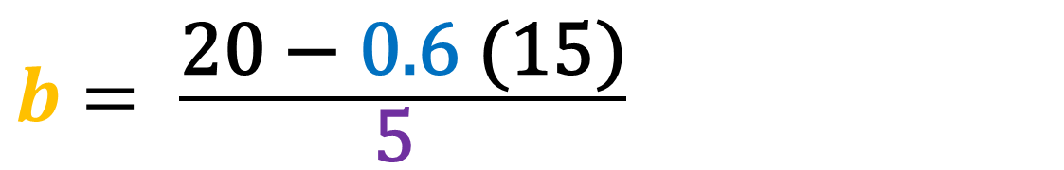
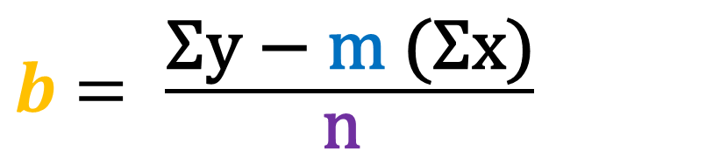

Calculate the Intercept
Σx | Σy | Σxy | Σx²
15 | 20 | 66 | 55
$b$ $= \frac{\text{Σ}\text{y}\text{ − }\text{m} \text{(}\text{Σ}\text{x}\text{)}}{\text{n} }$
$b$ $= \frac{\text{20}\text{ − }\text{0.6} \text{(15)}}{\text{5} }$
$$b =2.2$$
Notes:
Have you asked yourself the question, why do people organize?
Lets go to the psychology of organizing
This predictability applies within the context of our homes, manifesting through the concept of organization

Slide 25
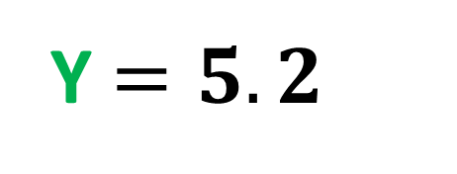
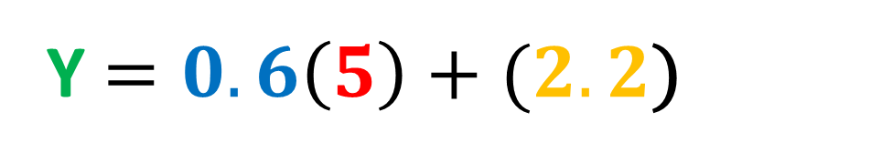
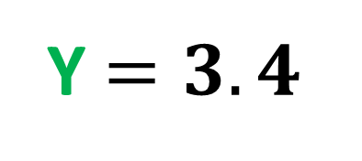
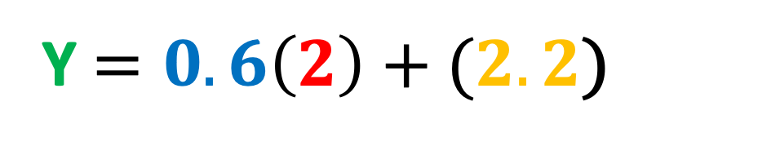

Least Squares Method
Price of Fuel (X) | Jeepney Fare (Y)
1 | 2
2 | 4
3 | 5
4 | 4
5 | 5
Y $=m\left(x\right)+b$
Y $=0.6\left(2\right)+(2.2$)
Y $=3.4$
Y $=0.6\left(5\right)+(2.2$)
m | b
0.6 | 2.2
Y $=5.2$
Notes:
Have you asked yourself the question, why do people organize?
Lets go to the psychology of organizing
This predictability applies within the context of our homes, manifesting through the concept of organization

Slide 26
Drawing the Regression Line
Price of Fuel (X) | Jeepney Fare (Y) | Predicted Jeepney Fare (Y_{predict})
1 | 2 | 2.8
2 | 4 | 3.4
3 | 5 | 4
4 | 4 | 4.6
5 | 5 | 5.2
Jeepney Fare (Y)
Price of Fuel (X)
Notes:
Have you asked yourself the question, why do people organize?
Lets go to the psychology of organizing
This predictability applies within the context of our homes, manifesting through the concept of organization

Slide 27
Least Squares Method
The blue points represent the actual Y values and the orange points represent the predicted Y values
Jeepney Fare (Y)
Price of Fuel (X)
Notes:
Have you asked yourself the question, why do people organize?
Lets go to the psychology of organizing
This predictability applies within the context of our homes, manifesting through the concept of organization

Slide 28
Least Squares Method
The distance between the actual values and the predicted values are known as residuals or errors
Residual
Jeepney Fare (Y)
Price of Fuel (X)
Notes:
Have you asked yourself the question, why do people organize?
Lets go to the psychology of organizing
This predictability applies within the context of our homes, manifesting through the concept of organization

Slide 29
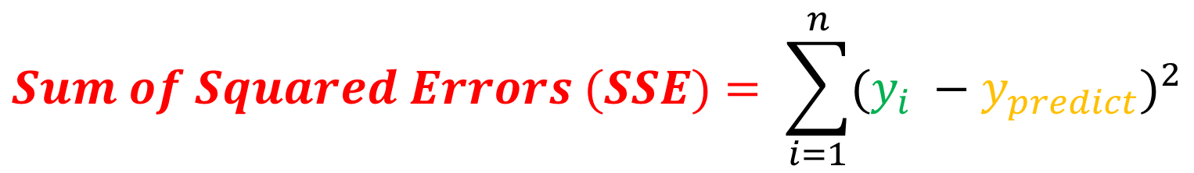
Loss Function
Price of Fuel (X) | Jeepney Fare (Y) | Predicted Jeepney Fare (Y_{predict}) | Y - Y_{predict} | (Y – Y_{predict})²
1 | 2 | 2.8 | -0.8 | 0.64
2 | 4 | 3.4 | 0.6 | 0.36
3 | 5 | 4 | 1 | 1
4 | 4 | 4.6 | -0.6 | 0.36
5 | 5 | 5.2 | -0.2 | 0.04
$$Sum of Squared Errors (SSE)= \sum_{i=1}^{n}{{(y_{i} −y_{predict})}^{2}}$$
Notes:
Have you asked yourself the question, why do people organize?
Lets go to the psychology of organizing
This predictability applies within the context of our homes, manifesting through the concept of organization

Slide 30
Loss Function
Price of Fuel (X) | Jeepney Fare (Y) | Predicted Jeepney Fare (Y_{predict}) | Y - Y_{predict} | (Y – Y_{predict})²
1 | 2 | 2.8 | -0.8 | 0.64
2 | 4 | 3.4 | 0.6 | 0.36
3 | 5 | 4 | 1 | 1
4 | 4 | 4.6 | -0.6 | 0.36
5 | 5 | 5.2 | -0.2 | 0.04
Jeepney Fare (Y)
SSE = 2.4
The sum of squared errors for this regression line is 2.4. This tells you how good a line is fitted to the data. The best fit line will have the least amount of this value.
Price of Fuel (X)
Notes:
Have you asked yourself the question, why do people organize?
Lets go to the psychology of organizing
This predictability applies within the context of our homes, manifesting through the concept of organization

Slide 31
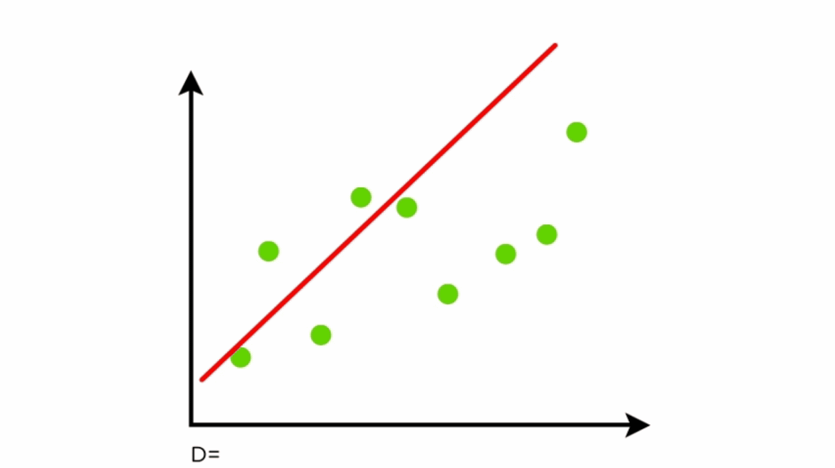
Finding the Best Fit Regression Line
We keep moving this line through the data points to make sure the best fit line has the least square distance between the data points and the regression line
Notes:
Have you asked yourself the question, why do people organize?
Lets go to the psychology of organizing
This predictability applies within the context of our homes, manifesting through the concept of organization

Slide 32
What is Linear Regression?
Classification vs Regression
Types of Linear Regression
Understanding Simple Linear Regression
Gradient Descent
Notes:
Have you asked yourself the question, why do people organize?
Lets go to the psychology of organizing
This predictability applies within the context of our homes, manifesting through the concept of organization

Slide 33
Gradient Descent
Gradient descent is an iterative optimization algorithm to find the minimum of a function. Here that function is our Loss Function.
Notes:
Have you asked yourself the question, why do people organize?
Lets go to the psychology of organizing
This predictability applies within the context of our homes, manifesting through the concept of organization

Slide 34
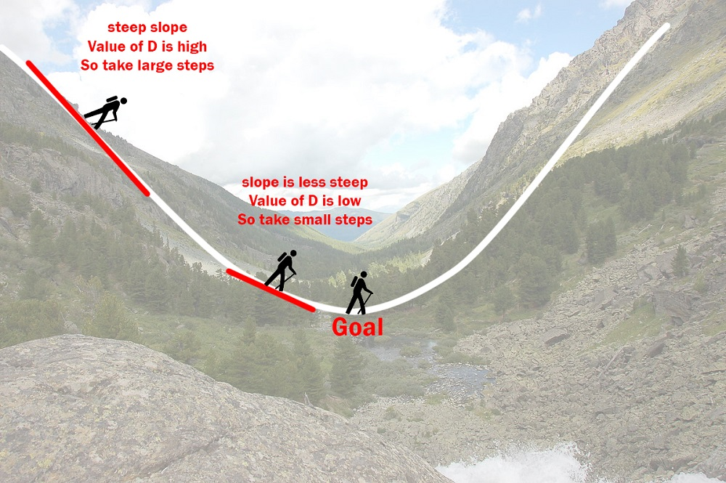
Going down a valley
Notes:
Have you asked yourself the question, why do people organize?
Lets go to the psychology of organizing
This predictability applies within the context of our homes, manifesting through the concept of organization

Slide 35
Gradient Descent
When going down a valley,
m (slope) is the current position of the person
D (partial derivative) is the steepness of the slope
L (Learning Rate) is the speed at which the person moves
L x D be the size of the steps the person will take
Notes:
Have you asked yourself the question, why do people organize?
Lets go to the psychology of organizing
This predictability applies within the context of our homes, manifesting through the concept of organization

Slide 36

When the slope is more steep he takes longer steps and when it is less steep, he takes smaller steps.
Finally he arrives at the bottom of the valley which corresponds to our loss = 0.
Notes:
Have you asked yourself the question, why do people organize?
Lets go to the psychology of organizing
This predictability applies within the context of our homes, manifesting through the concept of organization

Slide 37
Gradient Descent
Notes:
Have you asked yourself the question, why do people organize?
Lets go to the psychology of organizing
This predictability applies within the context of our homes, manifesting through the concept of organization

Slide 38
Gradient Descent
$$D_{m}= \frac{1}{n} \sum_{i=0}^{n}{2 \left(yi −\left(mxi+c\right)\right)(−xi)}$$
$$D_{m}= \frac{−2}{n} \sum_{i=0}^{n}{x_{i} \left(yi−\overline{y}i\right)}$$
$$D_{b}= \frac{−2}{n} \sum_{i=0}^{n}{\left(yi −\overline{y}i\right)}$$
Notes:
Have you asked yourself the question, why do people organize?
Lets go to the psychology of organizing
This predictability applies within the context of our homes, manifesting through the concept of organization

Slide 39
Gradient Descent
$$m=m −L ∗ D_{b}$$
$$b=b −L ∗D_{b}$$
Notes:
Have you asked yourself the question, why do people organize?
Lets go to the psychology of organizing
This predictability applies within the context of our homes, manifesting through the concept of organization

